Slide 1
CS 540 Database Management Systems
Welcome to CS 540!
Lecture1: Introduction
Arash Termehchy
The Structured Data Science Lab.

Slide 2
Evolution of data management
Manual processing: 1900
Mechanical punch-cards: 1900 - 1955
Stored-program computers: sequential record processing: 1955 - 1970
Online navigational network databases: 1965 - 1980
Relational Databases: 1980 - 1995
Post-relational and the Internet: 1995 -

Slide 3
The notion of database management system (DBMS)
W. McGee, Generalization: Key to Successful Electronic Data Processing, Journal of ACM, 1959.
Data processing was mostly ad-hoc programs
We need generalization (abstraction):
Operation: sort, select part of the file, …
File: A sequence of records
It makes our systems usable and scalable.
More people can use them
Easier to extend for large number of large data sets
Notes:
How to build models that provide nice generalizations
How to implement the efficiently

Slide 4
Generalization is in the key
How to develop correct and usable generalizations for data and query?
Data & Query Model: first part of the course
Relational model, Web data model, …
How to implement these models efficiently?
Data management systems: second part of the course
Storage management, access methods, ….
Notes:
How to build models that provide nice generalizations
How to implement the efficiently

Slide 5
Tell Us About You
Name
Department & program
Technical interests
Non-technical interests
How do you manage your data?

Slide 6
Course objective: Research in data management & analytics
How to develop novel data management models and systems?
Learn the fundamental ( and successful) ideas
Data and query models, data systems.
Studying classic and new research papers.
Develop new data models and systems!
Interesting and relevant database related problems.
Doing projects.
Apply the lessons learned from classic papers.
Notes:
Apply the ideas.

Slide 7
This course is not about learning basic concepts in data management
We do not discuss
ER model, relational model, relational algebra, SQL, database design, database programming,…
You should know them already
Take CS 340
We do not discuss how to tune or implement an application using MySQL, Oracle, …
We do not read and implement textbooks.
Notes:
How successful models & systems were built?
How to develop novel data management models and systems?

Slide 8
What are the new problems?
Relational database systems have been invented a long time ago ( in computer age!)

Slide 9
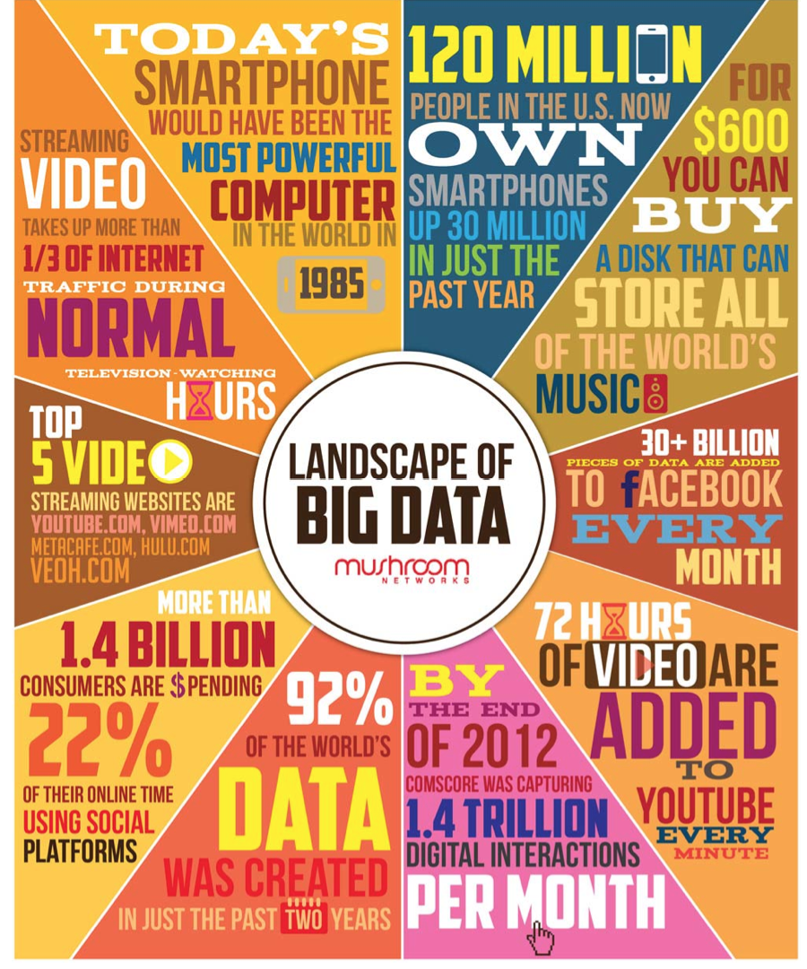
The arrival of Big Data
Technological shifts ( Web, cheap hardware, mobile, sensors, …) created a staggering number of enormous data sets.
There exists both opportunities and challenges.

Slide 10

Opportunities are priceless!
“In the mid-1850s, Dr. John Snow plotted cholera deaths on a map, and in the corner of a particularly hard-hit buildings was a water pump. A 19th-century version of Big Data, which suggested an association between cholera and the water pump.”
Not the one in Game of Thrones,
more influential!
Integrating data sets may save thousands of lives.

Slide 11
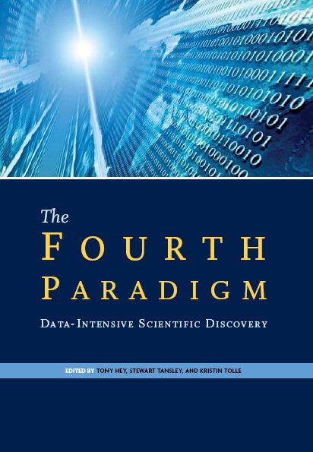
Paradigm Shifting impacts
“The Fourth Paradigm: Data-Intensive Scientific Discovery”, Jim Gray
Empirical
Theoretical
Computational: e-science
Sloan Sky Server is a top
cited resource in astronomy.
Notes:
Spread of diseases by analyzing Google query log
Personalized medicine, drug discovery, …

Slide 12
Unreasonable effectiveness of data
A. Halevy, The unreasonable effectiveness of data, IEEE Intelligence Systems, 2009.
More data outperforms complex statistical models in prediction and discovery.
Spread of diseases by analyzing Google query log
We do not need more complex statistical models.
A bit controversial at first!

Slide 13
Why cannot we use traditional data management technology to query and analyze our data sets?
What are we waiting for?

Slide 14
Traditional systems cannot deal with enormous data sets.
Hardon Colider can
generate 500 exabyte
per day.
Sloan Sky Server will
soon store 30 terabyte
per day.
Advances in hardware
outpaced DBMS technology.
Notes:
Advances in hardware have outpaced progress in algorithms and software!
Redo everything as the data evolves!

Slide 15
Traditional systems cannot deal with staggering number of data sets.
RDBMS used to deal with
a single static database.
We need to transform and
or integrate large number
of evolving data sets.
Impossible to do manually.
“If you’re an data integration
expert, you always find jobs!”
Notes:
Advances in hardware have outpaced progress in algorithms and software!
Redo everything as the data evolves!

Slide 16
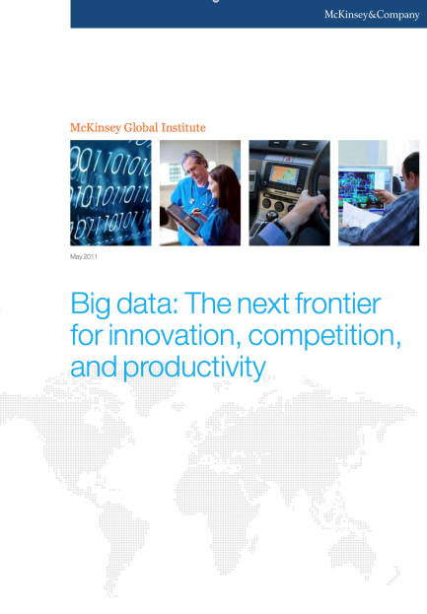
Current systems are not built for scientists and normal users.
“….(in the next few years) we project a need for 1.5 million additional analysts in the United States who can analyze data effectively…“,
-- McKinsey Big Data Study, 2012
“It may take a PhD in machine learning to successfully deploy a data analytics algorithm!”

Slide 17
How did we succeed before?
“These innovations give one of the best examples of research prototypes turning into products. The relational model, parallel database systems, active databases, and object-relational databases all came from the academic and industrial research labs. The development of database technology has been a textbook case of successful collaboration between academe and industry.”
Jim Gray, Evolution of Data Management

Slide 18
Our plan of attack
Learn the fundamental ( and successful) ideas
Data and query models, data systems.
Studying classic and new research papers.
Both theory and system building.
Develop novel data models and systems!
Interesting and relevant database related problems.
Doing projects.
Apply the lessons learned from the papers.
Notes:
Apply the ideas.

Slide 19
Learning the fundamentals: Paper review
Read and summarize the papers before the lecture:
What is the main problem discussed in the paper?
Why is it important?
What are the main ideas of the proposed solutions?
What are the final results of the paper?
Find an interesting question from the paper.
Post them on Piazza before 12:00 pm of the day of the class.
One paper per lecture marked by * in the course website, but you can skip two reviews.
Read the references on the course website on “how to read scientific papers”.

Slide 20
Learning the fundamentals: Lectures
Review and discuss the papers.
Will be available on the course website right before the class.
Provide the road map for studying
The papers can seem overwhelming.
Attendance is not required but encouraged.
Participate and ask questions!

Slide 21
Learning the fundamentals: Assignments
Three assignments: both written and programming.
Announced on Piazza and course website, posted on the course website.
You check your understanding of the fundamental concepts, algorithms, and systems.
Submit using TEACH
Write using word processors and submit in pdf format.
Start early!!!

Slide 22
Learning the fundamentals: Exam
Midterm exam in class.
Closed books and notes
Tests your knowledge of the papers and subjects discussed in the class.
No final exam (instead you work on your projects).

Slide 23
Building new model/system: Project
A small research project on data management
Theory, system building, or evaluating current systems.
Novel: managing staggering number of large databases.
Challenging: more than well-specified implementation.
Groups of 1 – 4 students.
You may choose one of the suggested projects or pick a project related to the course material.

Slide 24

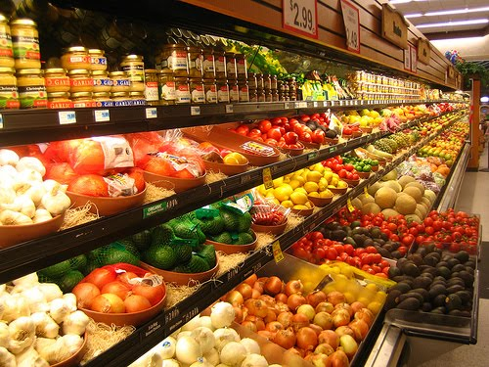

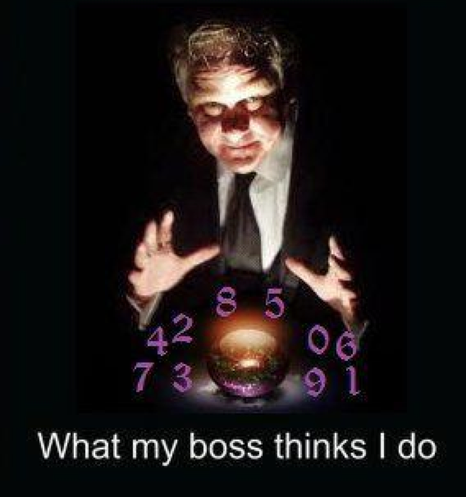


Example: Universal Data Analytics
Big Data is extremely heterogeneous!
Each data analytic algorithm requires its input to be organized in a certain way.
Data Scientist
Notes:
Data scientists spend a lot of time finding desired organization of an algorithm and converting their data to such organization.

Slide 25

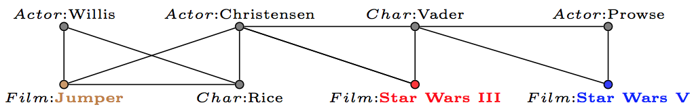

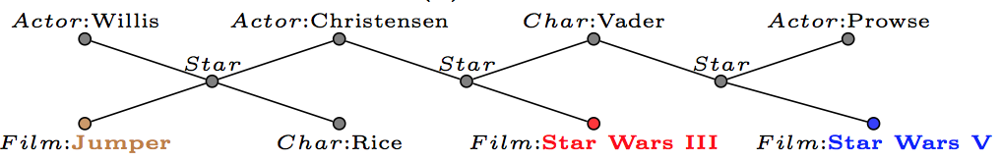
Universal Data Analytics:
Example:
Notes:
One has to understand the algorithm to find the right organization.

Slide 26
Current algorithms work well on some organizations and terrible on others.
Query: Find the most similar movie to Star Wars III
Notes:
One has to understand the algorithm to find the right organization.

Slide 27
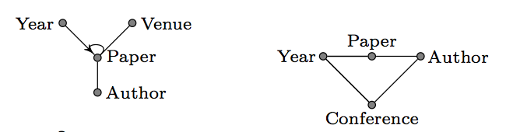
Scientific merit: it is hard to measure the effectiveness of an algorithm.
Two papers from the same research group that use the same data set (DBLP).
The smartness of the algorithms depends on data representation!
Notes:
One has to understand the algorithm to find the right organization.

Slide 28
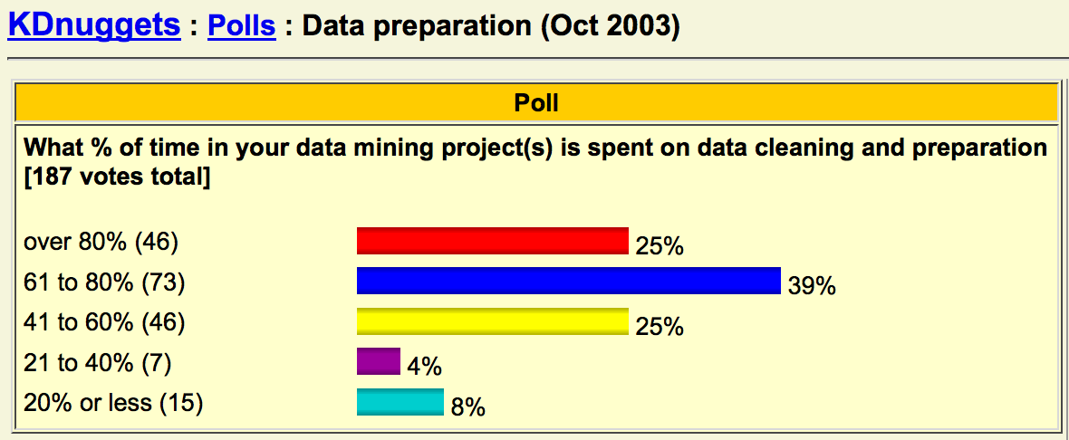
Data scientists have to find the right representation!
Goal: Develop algorithms that return the same answers over different representations of the same data set.

Slide 29
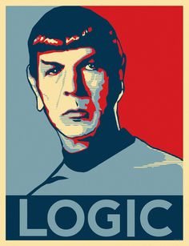
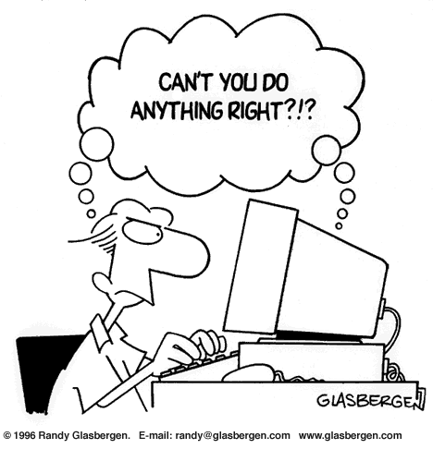
Human Centric Databases
Logic-based languages, e.g. SQL, are the main method of modeling and querying data.
Ordinary users do not know these languages, make mistake, have incomplete information, … . They’re only human!
Goal: Develop expressive and easy-to-use query interfaces.

Slide 30
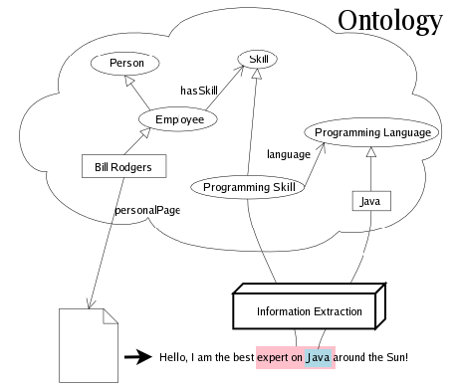
Example Project: Automatic Database Design
We usually have to organize unstructured information to explore it.
Information extraction,
image annotation, ....
Which concepts to extract?
Currently done manually.
Notes:
One has to understand the algorithm to find the right organization.

Slide 31
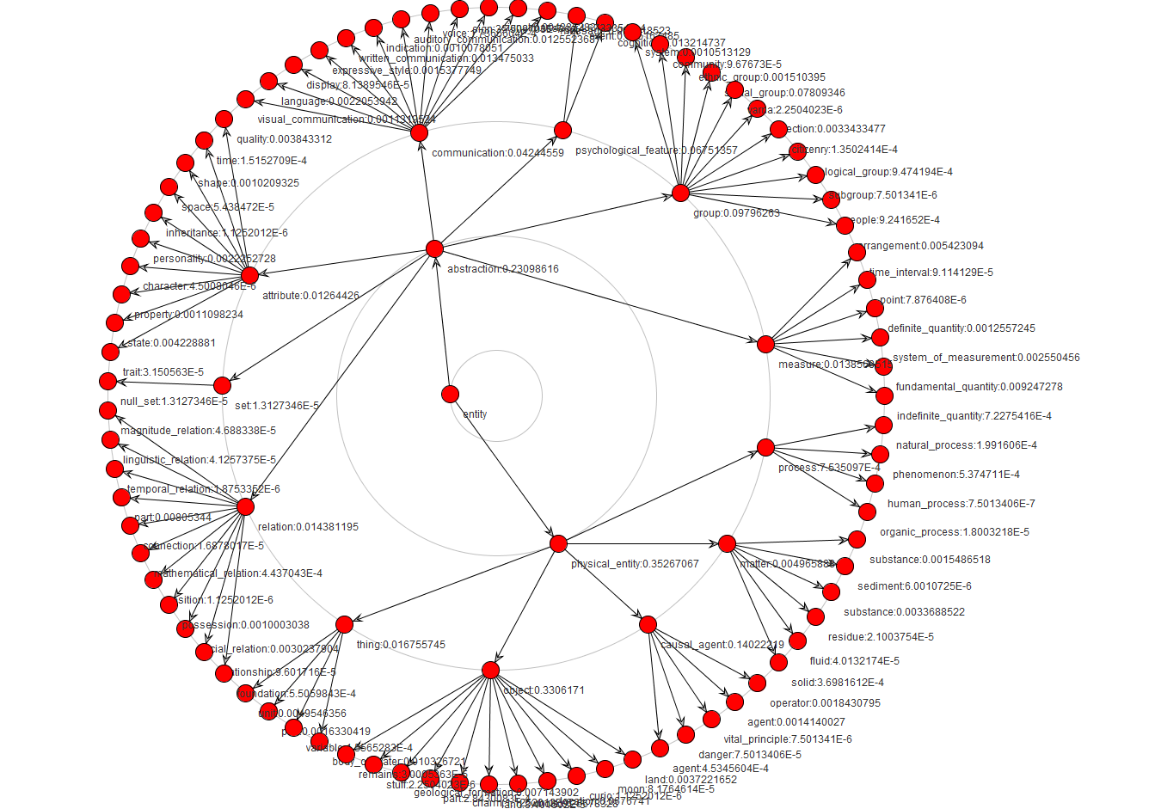
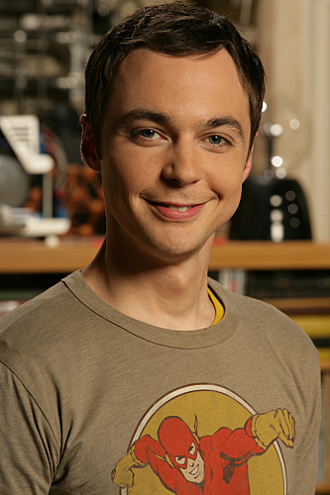
Each domain has a large number of concepts.
Yago ontology up to level 3
Concepts extraction is time and resource-intensive.
It is not useful to extract too many concepts,
Sheldon problem
Goal: Find cost-effective and usable organization for information.
We will overview selected topics on January 15th.
Notes:
One has to understand the algorithm to find the right organization.

Slide 32
Building new model/system: Project
Project proposal:
Group members
What do you want to solve?
Relevant references (1 - 3)
Which tools, data sets, systems you will use?
Midterm report: 3-4 pages
Detailed description of the problem
Your approach to solve it.
Review of the related references (1-5)
Your progress, challenges, and your plan to solve them.
Presentation in class: 15 minutes (12 + 3 Q&A)
Final report: Expand midterm report to 5-7 pages.
Expand on solutions
More detailed comparison with the related work
Section on empirical studies
Conclusion.

Slide 33
Building new model/system: Project
You get feedback from the course staff in every step.
Graded based on technical depth, novelty, and presentation.
Check out the course website for more information.
A list of suggested projects posted by this Thursday.
Start early!!!
Form group in the first couple of weeks

Slide 34
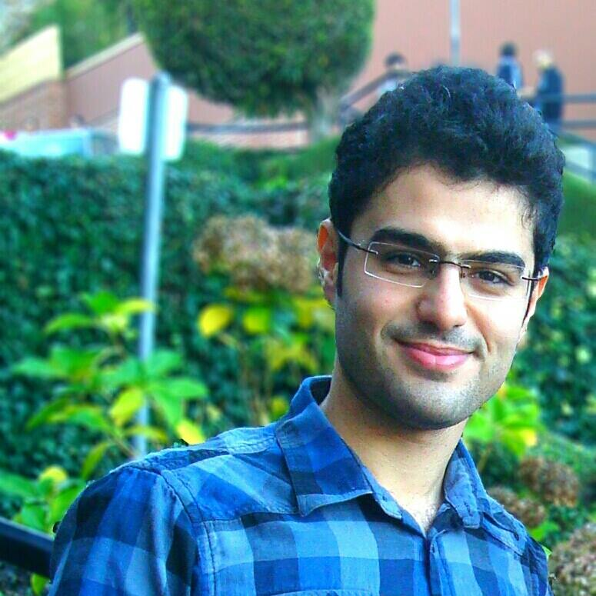
How to get the most out of the course?
Communicate with the course staff
Piazza (replaces email list)
Email ([cs540])
Office hours
Arash: Tuesday/ Thursday 3:00 – 3:50pm
Vahid: Wednesday 9:00 – 10:00 am
Communicate with your peers on papers and lectures.
Check the course website for announcements or possible changes in the course schedule.

Slide 35
What is next?
A classic paper on relational model and languages by their inventor.
What were the goals, challenges, and successes?
How data models evolved?

